Slide 1
ALAMON & Telmon Joining forces
An EMPLOYEE OWNED COMPANY

Slide 2
EFFECTIVE Sept. 1, 2020
What happens now?
Scott Harrison is executive leader of the Telmon group.
All employees will be hired by Alamon.
Dyrk and Jackie are stepping down.
All Telmon customers are coming along.
All key vendors are coming along (Field Nation, etc.).
You become part of the Alamon family.
What doesn’t change?
What you do each day. You keep serving Telmon customers.
How you do things each day. No changes, keep making Telmon a success.
The Telmon name brand continues.

Slide 3
The plan FOR ALAMON AND TELMON
Alamon: a Montana company created in 1975. Telmon: a Montana company created in 1990.
Both companies were derived from the Communications Industry, but provide different services to customers.
Telmon employees and customers are critical, and an extremely important part of the acquisition.
There are opportunities for both companies to learn from each other and create a better company together.
The cultures and desire to take care of the customer are similar.
Combining with Alamon will provide opportunities for Telmon employees and customers.

Slide 4
The plan FOR ALAMON AND TELMON
Alamon provides increased administrative capabilities (details to follow later in the presentation).
Dyrk Eddie wanted to ensure Telmon employees and customers were taken care of as he steps down from Telmon.
Alamon is an Employee Owned Company, providing employees with an Employee Stock Ownership Plan (ESOP). Details to follow later in the presentation.
This is Alamon’s first acquisition! Alamon has grown organically from revenue of $15 million in Fiscal 2016 to $34 million in Fiscal 2020 (June 30th year end).

Slide 5
Impact to you, effective September 1, 2020
You are hired at your current wage.
Your tenure with Telmon is considered with benefits. The only exception is with the Alamon, Inc. Employee Stock Ownership Plan (rule limitations).
Medical & Dental Coverage effective on day 1 (improved medical plan with lower costs to you with much lower plan deductibles). If you are currently in the Telmon medical/dental plan, then your coverage continues with Alamon (Allegiance/Cigna).
After this update, you will be sent an offer letter with all supporting information through DocuSign. We have included a detailed benefit comparison. Please review and complete by Thursday end of day.
New Alamon company credit cards are in-house and will be issued this week. Do not use Telmon company credit cards as of September 1.
You will continue to use your current mobile phone for now. Alamon will issue new phones in the future.
Alamon has purchased Telmon company vehicles. If you drive a company vehicle, there are no changes pending. You will continue to drive it.

Slide 6
ALAMON SERVICES
Wireless Services
Utility Services
Network Services
5G Equipment Installation
Microwave Installation and Line of Sight Surveys
Network Edge Equipment Installation
Small Cell Deployment
Maintenance Services / Emergency Response
Pole Inspection and Treatment
Pole Reinforcement
Non-Destructive Pole Testing (Resistograph)
Data Delivery
Pole Loading Analysis
Testing / Upgrades
Fiber Characterization
Site Preconditioning and Physical Installation
Network and Structured Cabling
Data Centers

Slide 7
ALAMON SERVICES
DC Power Services
Energy Services
Outside Plant Services
Field Engineering
Detail Engineering
DC Plant Installations, Upgrades, Replacements and Migrations
VRLA and Flooded Batteries
Spill Containment Systems
Battery Energy Storage Systems (BESS) In-Building
Battery Energy Storage Systems (BESS) Modular Container Solutions
Battery Energy Storage Systems (BESS) Monitoring Systems
Renewable Energy Project Installation
FTTH - Fiber to the Home Installation
Aerial and Buried Drop Placement
Fiber Splicing and Testing
Copper Splicing
OSP - Inspecting

Slide 8
ADMINISTRATIVE CAPABILITIES
We bring expanded Administrative Capabilities to the
union of Alamon and Telmon, with dedicated personnel
in these departments:
Safety
Fleet Management
Accounting
Human Resources
Information Technology
Recruiting

Slide 9
POSITIONED FOR GROWTH
COVID-19 IMPACT
Our teams are all over the nation, and our employees have been able to stay healthy.
Strong Safety Program.
Alamon employees are considered essential and are able to continue to work through the pandemic.
FINANCIAL STABILITY
Alamon is a financially sound company with continued growth potential.
Alamon’s business strategy is built on taking educated risks.

Slide 11
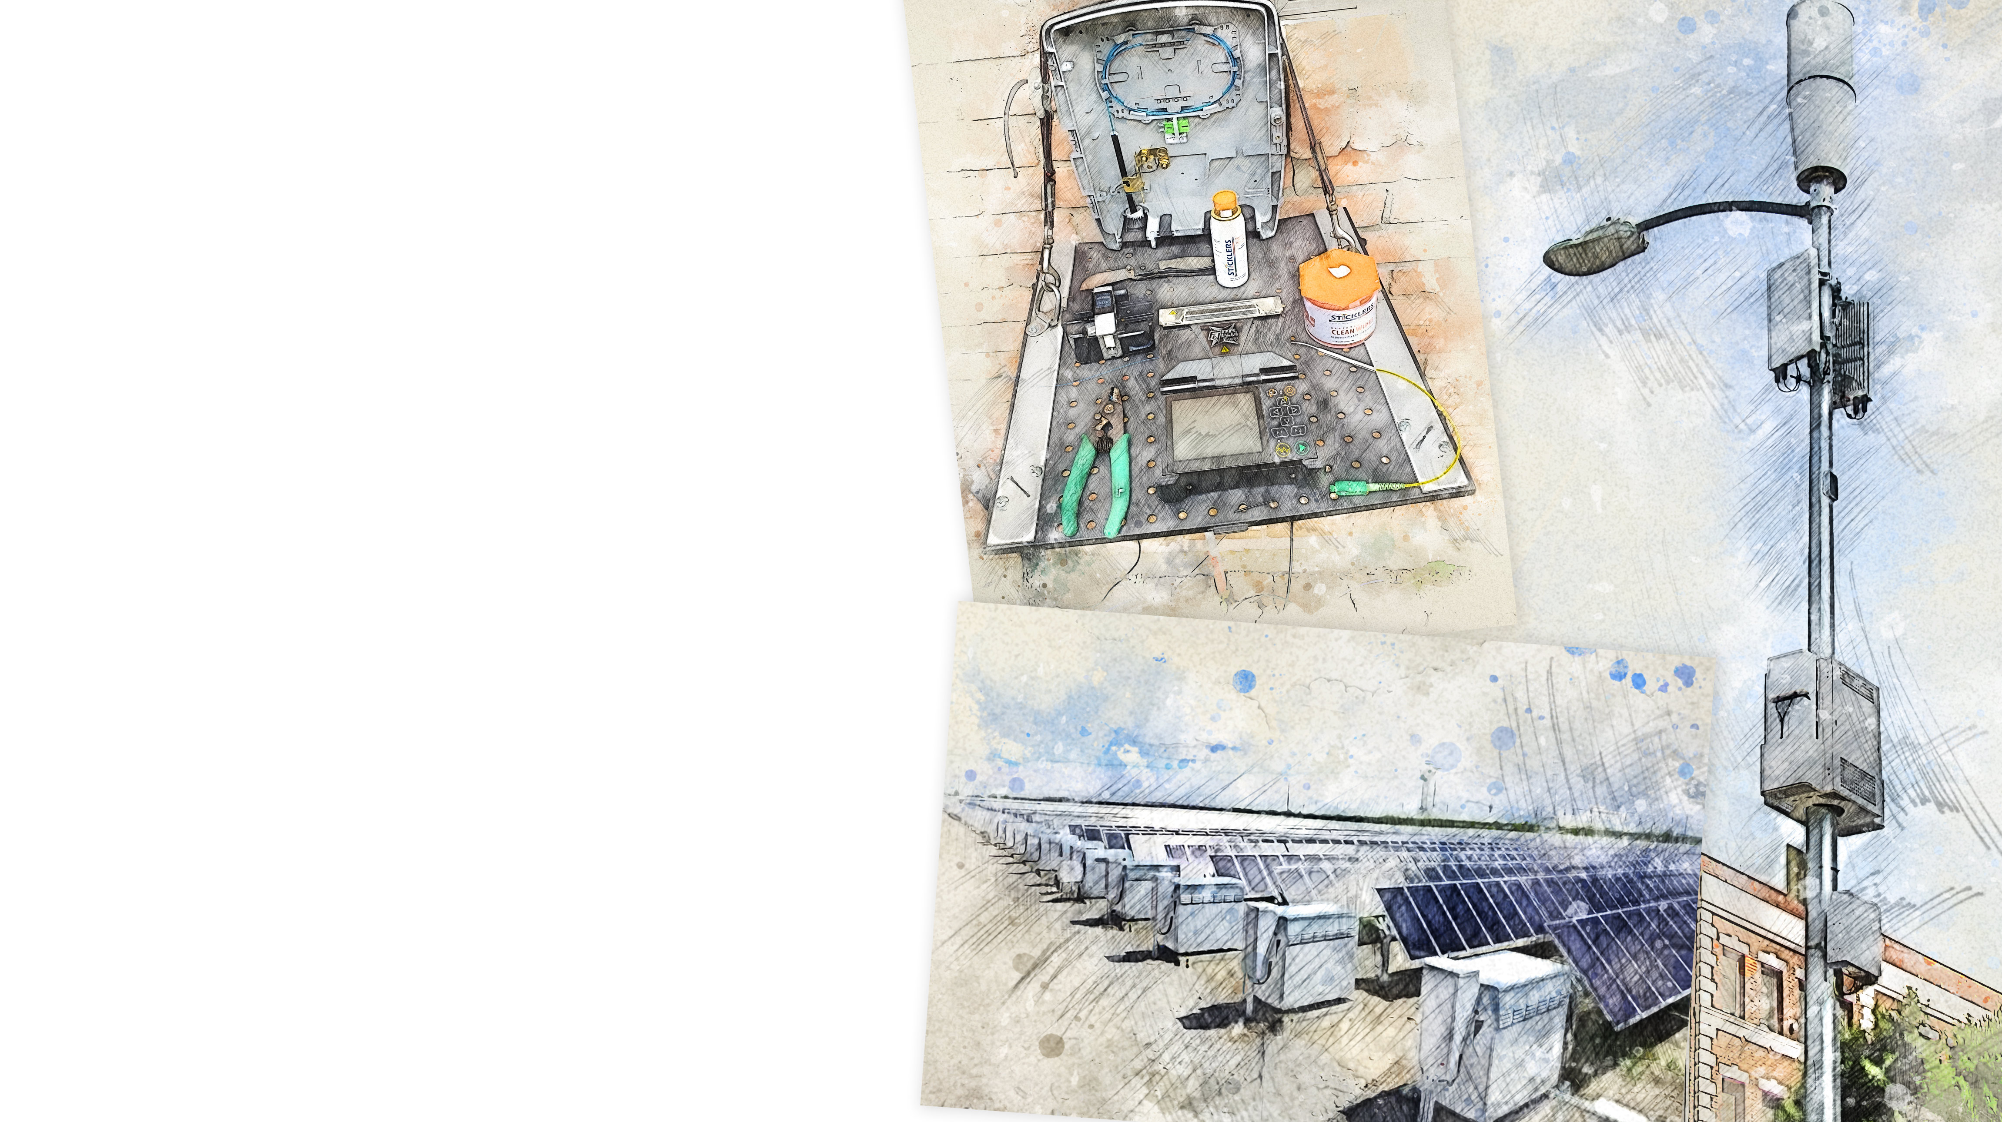
READY FOR 2021
Fiber to the home
ENTERING NEW FISCAL YEAR 2021
(July through June)
5G technology
We are winning new customers, including some of the nation’s top service providers, value-added resellers and equipment manufacturers. Among them: T-Mobile, Black & Veatch, and Ziply Fiber.
Our services are right in line to help deliver 5G nationwide.
We are looking to win and have several customers in Energy Storage.
Growth through Acquisition Strategy.
Renewable energy

Slide 12
ESOP FUNDS YOUR RETIREMENT
IRA
ESOP
401K
Personal Retirement Account
“Special” IRS Retirement Account
Retirement Account
How it works:
How it works:
How it works:
You contribute YOUR money. Your employer may or may not contribute.
You contribute YOUR money.
Alamon contributes ALL money into YOUR account.

Slide 13
HOW HAS ALAMON’S ESOP PERFORMED?

Slide 14
OVERALL VALUATION
THROUGH JUNE 30, 2019
Alamon share value has increased over the last three years as the company and its employees have performed very well.
Revenue and profits have grown.
$9,000
$8,000
$7,000
$6,000
$5,000
$4,000
$3,000
$2,000
$1,000
$0
 | PER SHARE | VALUATION | PER SHARE CHANGE $ | PER SHARE CHANGE %
FY2016 | $21.29 | $4,825
FY2017 | $25.21 | $5,712 | $3.92 | 18.4%
FY2018 | $31.97 | $7,243 | $6.76 | 26.8%
FY2019 | $39.03 | $8,845 | $7.06 | 22.1%
Equity Value of Alamon
Per Share
Valuation

Slide 15
QUESTIONS ?

Slide 16
We are Glad Telmon is part of our Family.
WELCOME, NEW EMPLOYEE OWNERS!

